Slide 1
EMAIL SPAM DETECTION USING MACHINE LEARNING ALGORITHMS
By
PILLI MOUNIKA DEVI
VP21CSCI0200101
M.Sc. Data Science(Section-B)
Under the Guidance of
DR.M.SESHASHYAYEE
Dept. of Computer Science
GITAM School of Science
GITAM ( Deemed to be University)

Slide 2
Outline Introduction Existing system Proposed System Processes Modules Requirements Specification Conclusion

Slide 3
Introduction
Email Spam has become a major problem nowadays, with Rapid growth of internet users, Email spams is also increasing. People are using them for illegal and unethical conducts, phishing and fraud. Sending malicious link through spam emails which can harm our system and can also seek in into your system. Creating a fake profile and email account is much easy for the spammers, they pretend like a genuine person in their spam emails, these spammers target those peoples who are not aware about these frauds. So, it is needed to Identify those spam mails which are fraud, this project will identify those spam by using techniques of machine learning, this paper will discuss the machine learning algorithms and apply all these algorithm on our data sets and best algorithm is selected for the email spam detection having best precision and accuracy .svm,RandomForest,Knn and ensemble classifiers are proposed in our system

Slide 4
Existing System
Agarwal and T. Kumar. Harisinghaney et al. (2014) and Mohamad & Selamat (2015) have used the “image and textual dataset for the e-mail spam detection with the use of various methods.
Harisinghaney et al. (2014) have used methods of KNN algorithm, Naïve Bayes, and Reverse DBSCAN algorithm with experimentation on dataset. For the text recognition, OCR library” is employed but this OCR doesn’t perform well. Mohamad & Selamat (2015) uses the feature selection hybrid approach of TF-IDF (Term Frequency Inverse Document Frequency) and Rough pure mathematics.
There is some related work that apply machine learning methods in email spam detection, A. Karim, S. Azam, B. Shanmugam, K. Kannoorpatti and M. Alazab. They describe a focused literature survey of Artificial Intelligence Revised (AI) and Machine learning methods for email spam detection.
.

Slide 5
Aim & objective
There is a great scope in building email spam classifiers, as the private companies run their own email servers and want them to be more secure because of the confidential data, in such cases email spam classifier solutions can be provided to such companies.

Slide 6
Proposed System
In this proposed system, a dataset from “Kaggle” website is used as a training dataset. The inserted dataset is first checked for duplicates and null values for better performance of the machine. Then, the dataset is split into 2 sub-datasets; say “train dataset” and “test dataset” in the proportion of 70:30. Then the “train” and “test” dataset is then passed as parameters for text-processing.
In text-processing, punctuation symbols and words that are in the stop words list are removed and returned as clean words. These clean words are then passed for “Feature Transform”. In feature transform, the clean words which are returned from the text-processing are then used for ‘fit’ and ‘transform’ to create a vocabulary for the machine. The dataset is also passed for “hyperparameter tuning” to find optimal values for the classifier to use according to the dataset.
After acquiring the values from the “hyperparameter tuning”, the machine is fitted using those values with a random state. The state of the trained model and features are saved for future use for testing unseen data. Using classifiers from module sklearn in python, the machines are trained using the values obtained from above

Slide 7
The processes / Modules:
Email dataset An email dataset is prepared for the Spam mail detection system. Different emails are randomly collected from Ling spam dataset [19]. The dataset consists of total number of 1000 emails both ham and spam emails for the classification purpose. Since the approach considered is bagging approach, the dataset is divided into sets for each classifier algorithm. Two sets of 500 emails each have been prepared. Out of which 300 emails each are used for training purpose for both the Naïve Bayes and J48 algorithm and 200 each for the testing purpose

Slide 8
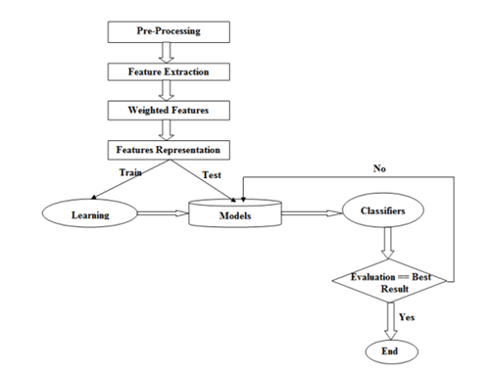
Data flow diagram

Slide 9
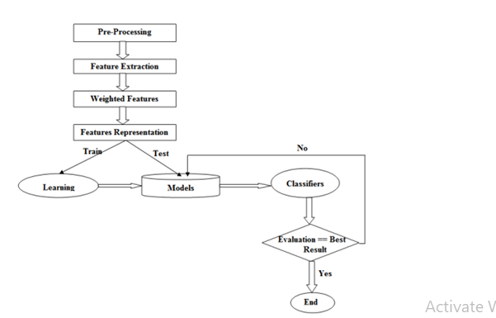
Data flow diagram

Slide 10
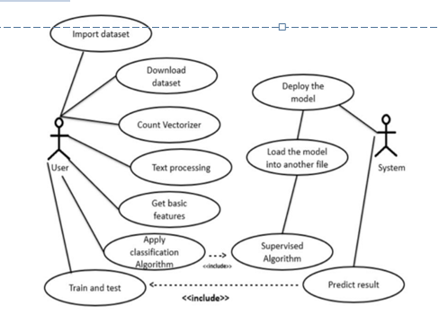
Use case

Slide 11
REQUIREMENT SPECIFICATION
SYSTEM REQUIREMENTS:
HARDWARE REQUIREMENTS:
System : Pentium i3 Processor.
Hard Disk : 500 GB.
Monitor : 15’’ LED
Input Devices : Keyboard, Mouse
Ram : 2 GB
SOFTWARE REQUIREMENTS:
Operating system : Windows 10.
Coding Language : Python

Slide 12
Conclusion
The machine learning model used by Google have now advanced to the point that it can detect and filter out spam and phishing emails with about 99.9 percent accuracy. The implication of this is that one out of a thousand messages succeed in evading their email spam filter.

Slide 13
Thank You

